Slide 1
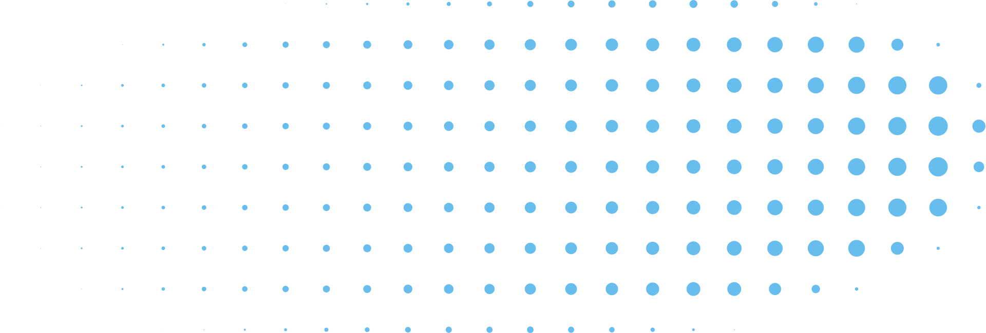
SKIP-YOLO: DOMESTIC GARBAGE DETECTION USING DEEP LEARNING IN COMPLEX MULTI-SCENES
Daffodil International University | Spring 2026
1

Slide 2

ARTIFICIAL INTELLIGENCE (CSE316)
65_A , GROUP-02
Presented To
Presented By
Shafin Ahmed (232-15-184)
Sakib Ahmed (232-15-085)
Abdul Alim (232-15-051)
Ariful Islam Redowan (232-15-734)
Samia Nawshin
Assistant Professor
Department of CSE
Daffodil International University
Daffodil International University | 2026
2

Slide 3
TOPICS
Problem Overview
Base Model: YOLOv3
Proposed Model: Skip-YOLO
Architecture with Pipeline
Dataset
Training Setup
Evaluation Metrics
Results
Why Skip-YOLO Works Better?
Real-Life Application
Daffodil International University | 2026
3

Slide 4
Problem and Base Model
-ARIFUL ISLAM REDOYAN (232-15-734)
4

Slide 5
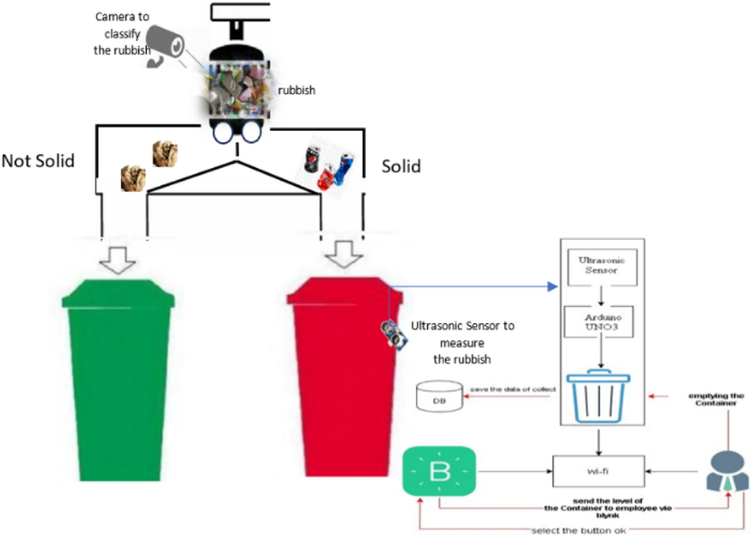
Problem Statement
Why Garbage Detection is Difficult?
In real-life environments, garbage detection is not easy because objects often appear in complex and messy backgrounds. It also becomes difficult due to different lighting and when garbage is hidden or broken.
Objects look similar (banana peel vs paper)
Background is complex (grass, road, room)
Same class garbage looks different in different scenes
Traditional models make wrong detection
⚠️ Why It Matters
Effective waste management needs fast and accurate garbage detection to sort and recycle waste properly.
Waste sorting is important for environmental protection 🌱
Manual sorting is slow and costly
A smart AI system is needed for fast and efficient detection
Incorrect detection can disrupt the recycling process
5

Slide 6
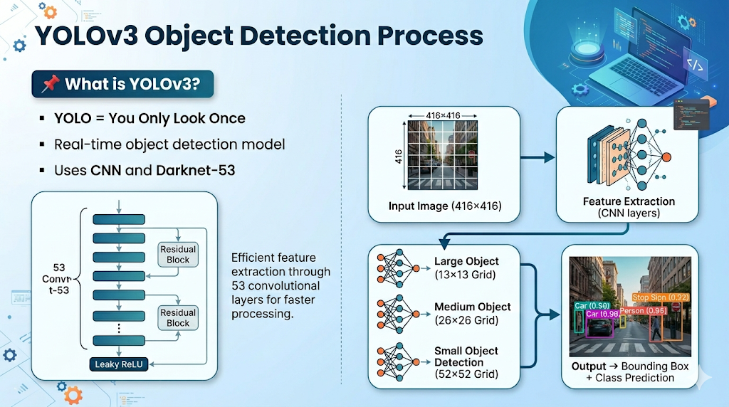
Base Model – YOLOv3
📌 What is YOLOv3?
YOLOv3 is a fast model that detects objects in one go using deep learning and works on different object sizes. But in real-life garbage detection, it struggles with similar-looking trash, messy backgrounds, and can sometimes be less accurate.
⚙️ How it Works
Input Image (e.g., 416×416)
Feature Extraction (CNN layers)
Multi-scale detection (small + large objects)
Output → Bounding Box + Class Prediction
6
YOLO = You Only Look Once
Real-time object detection model
Uses CNN and Darknet-53

Slide 7
Proposed Model: Skip-YOLO (Main Idea) & Architecture (Model Structure)
-SHAFIN AHMED (232-15-184)
7

Slide 8

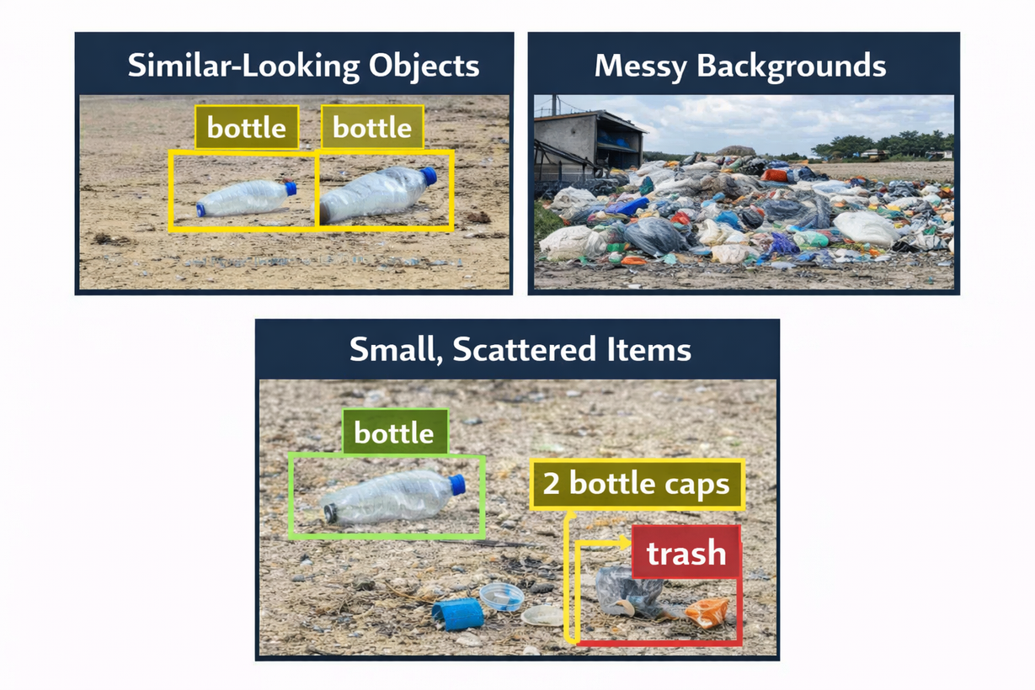

Proposed Model (Skip-YOLO Overview)
Improved version of YOLOv3
Designed for garbage detection
Handles:
- similar-looking objects
- messy backgrounds
- small scatter items
Photos retrieved from Google Gemini
Presented By Shafin Ahmed (232-15-184)
8

Slide 9
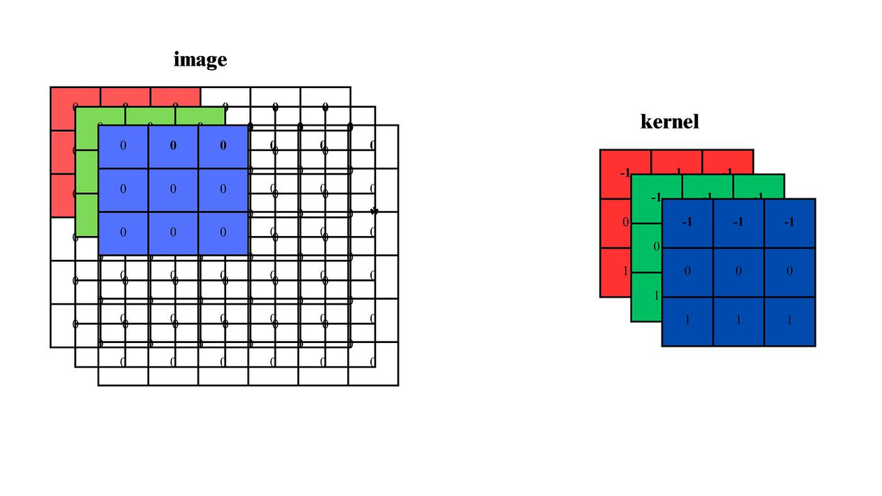

Improvement 1 – Large Convolution Kernel
7×7 kernel
Can see larger area
Understand the surrounding context better
OD becomes accurate
Presented By
Shafin Ahmed (232-15-184)
Photo retrieved from Google Gemini
9

Slide 10
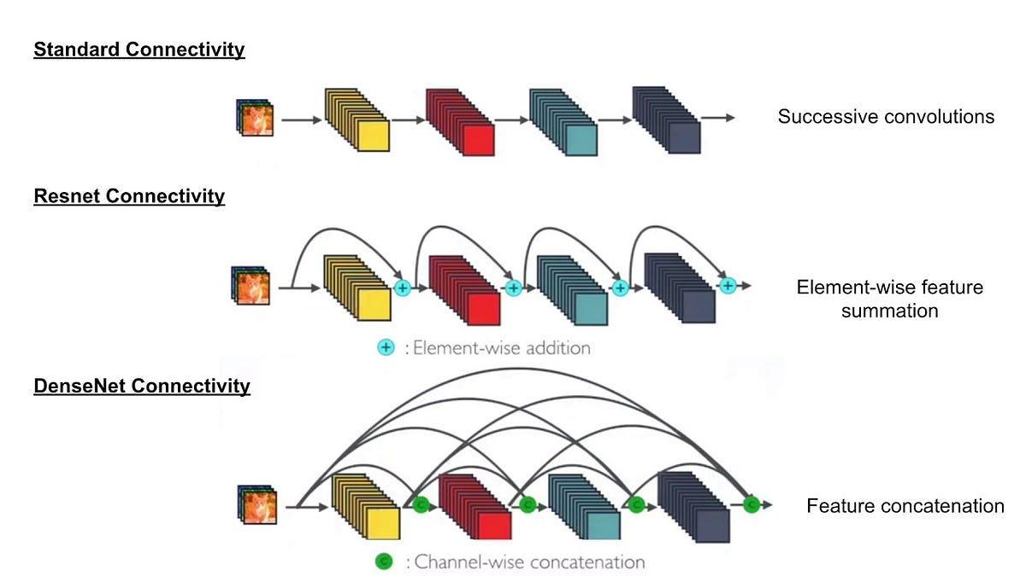
Improvement 2 – Dense Convolution Block
CNN: Layer work one after another
All layers connected
Feature reuse (edges, colors, shapes)
Learning become stronger
Reduce overfitting
Presented By
Shafin Ahmed (232-15-184)
Photo retrieved from Google Gemini
10

Slide 11
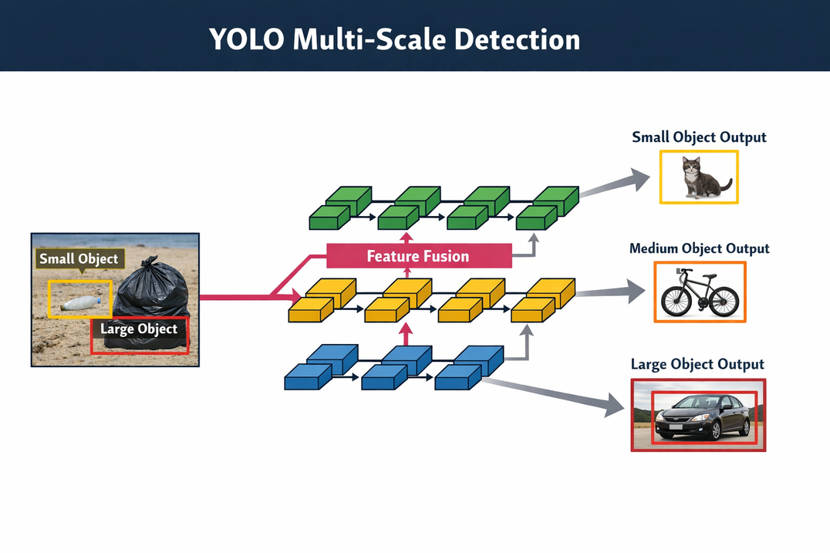
Improvement 3 – Multi-scale Fusion
Combines features
LL capture fine details
DL → High level info.
Detects small + large objects
Improves accuracy in complex scenes
Figure: Skip YOLO Multi Scale Detection
Presented By
Shafin Ahmed (232-15-184)
Photo retrieved from ChatGPT
11

Slide 12
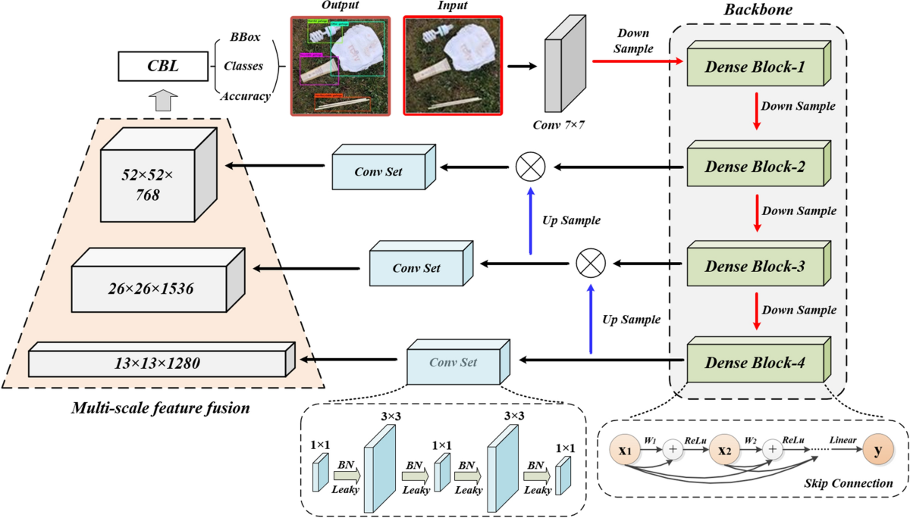
Skip-YOLO Architecture
Figure: Skip-YOLO Architecture
Presented By
Shafin Ahmed (232-15-184)
Photo retrieved from the actual source
12

Slide 13
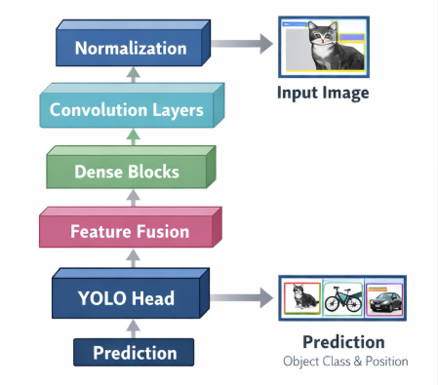
Skip-YOLO Pipeline
Input → normalized image (416×416)
7X7 Convolution→ feature extraction
Dense blocks → deep learning
Fusion → multi-scale features
YOLO head → prediction
Output: class + bounding box
Presented By
Shafin Ahmed (232-15-184)
Photo retrieved from Google Gemini
13

Slide 14
DATASET ,TRAINING SETUP & EVULATION METRICS
-SAKIB AHMED (232-15-085)
14

Slide 15
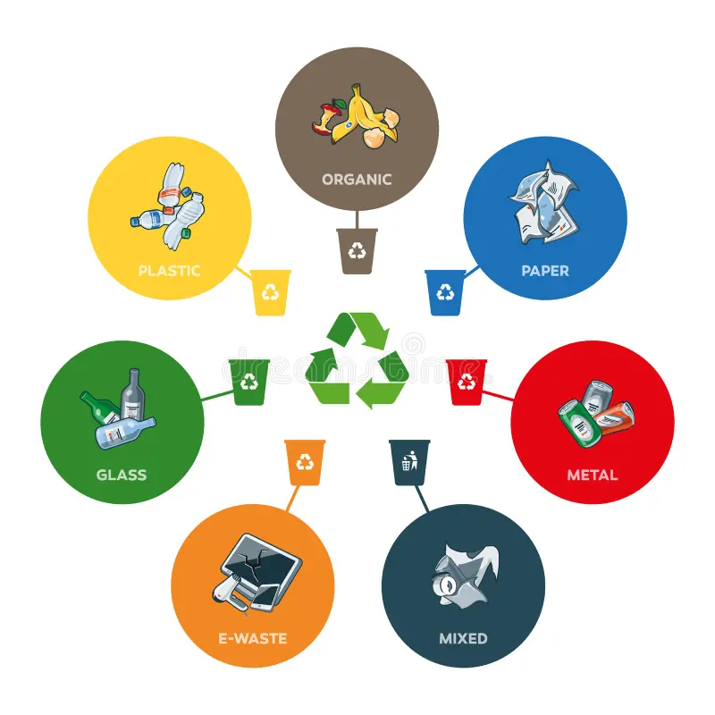
Dataset
Dataset Description:
Custom dataset developed for real-life garbage detection
Images collected from:
Indoor environments (dormitory, garbage bags)
Outdoor environments (grass, streets, pavement)
Focus on complex and realistic scenes
Designed to reflect real-world challenges
Garbage Categories:
Dataset
Classification Classes
1.♻️ Recyclable Waste
2.🚫 Non-Recyclable Waste
3. ☠️ Harmful Waste (battery, medicine, etc.)
4.📦 Other Waste
its uses for Simulates real-world waste sorting systems
Presented By
Sakib Ahmed (232-15-085)
Photos retrieved from Google Gemini
15

Slide 16
Data Distribution:
Total Images: 1218
304 → Single-class images
914 → Multi-class images
Multi-class images improve real-world detection capability
Training Setup
Model Training Configuration
Image Size: 416 × 416
Model: YOLOv3 (base architecture)
Framework: Darknet
GPU: GTX 1660Ti
Training Strategy:
Multi-scale training
Iterative learning
Training Parameters
Learning Rate: 0.001
Momentum: 0.9
Weight Decay: 0.0005
Its Ensures stable, efficient, and balanced learning
Presented By
Sakib Ahmed (232-15-085)
16

Slide 17
Evaluation Metrics
Performance Measurement:
Precision (P)
Recall (R)
mAP (Mean Average Precision)
Standard metrics for object detection models
Recall
Measures detection completeness
Formula:
R = TP / (TP + FN)
High Recall → Fewer missed objects
Precision
Measures correctness of predictions
Formula:
P = TP / (TP + FP)
High Precision → Fewer false detections
mAP
Measures overall model performance
Combines precision across all classes
Common metric: mAP@50
Higher mAP → Better detection accuracy
Presented By
Sakib Ahmed (232-15-085)
17

Slide 18
The results, performance, and application of Skip-YOLO.
-ABDUL ALIM (232-15-051)
18

Slide 19
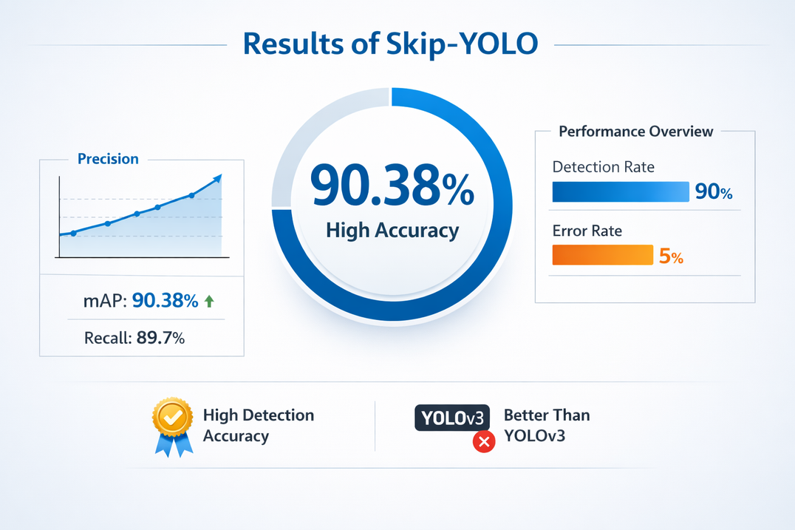
Results
mAP = 90.38%
High detection accuracy
Better than YOLOv3
Result of Skip-YOLO
19

Slide 20
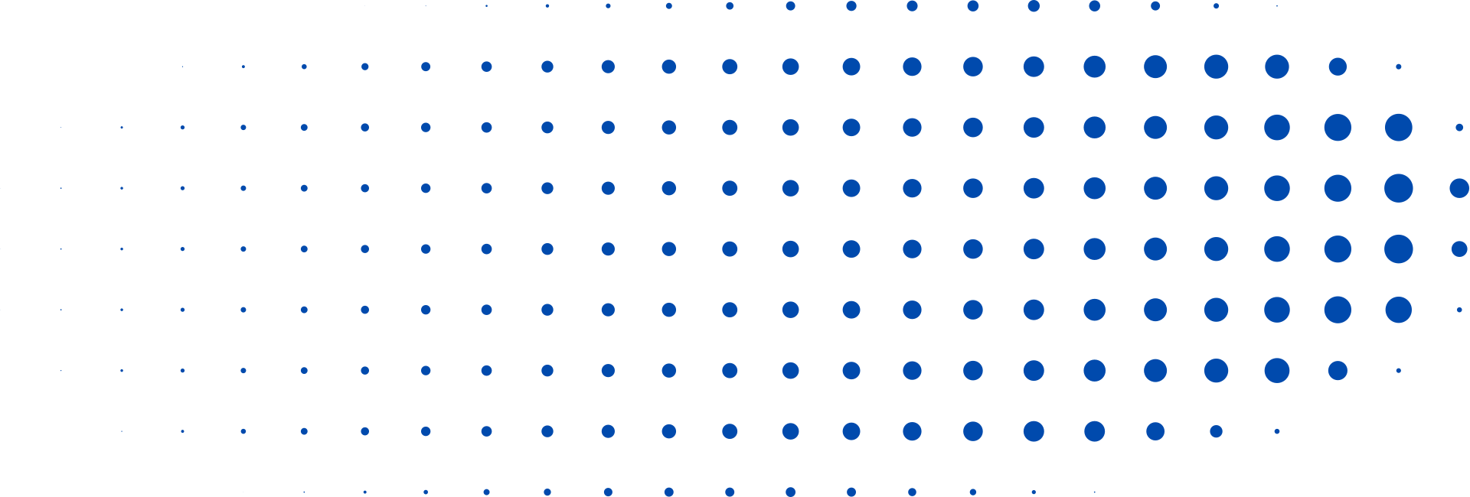
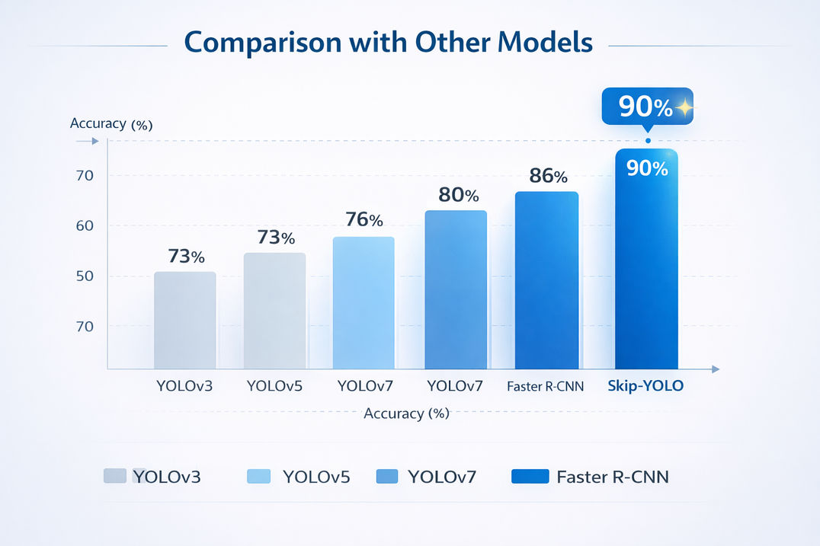
Probability given evidence
Model Comparison
YOLOv3: 73%
YOLOv7: 80%
Faster R-CNN: 86%
Skip-YOLO: 90%
coparison with other models

Slide 21
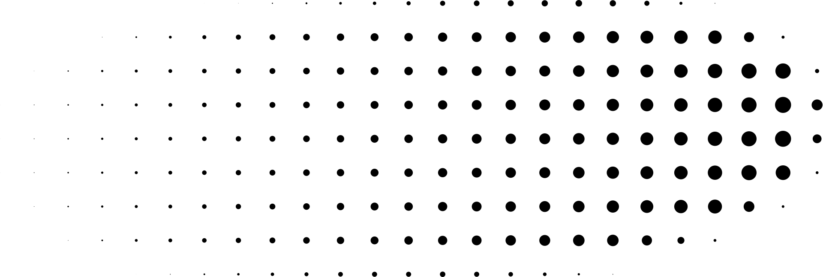
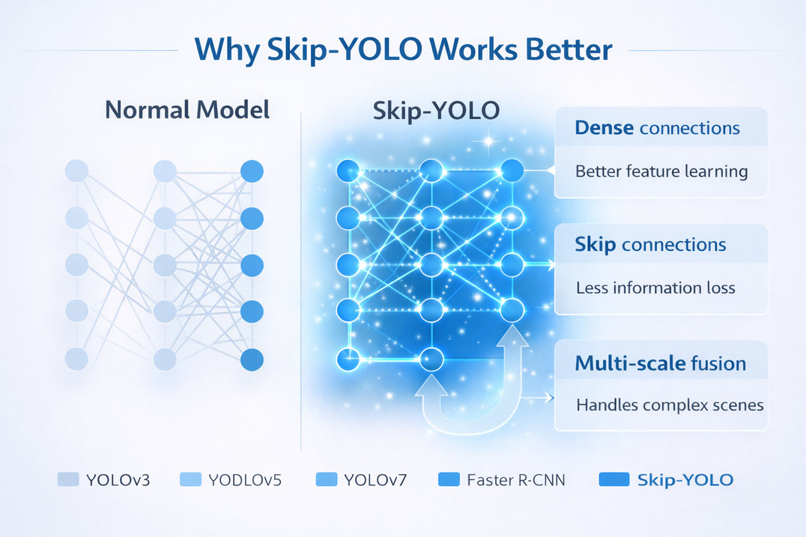
Why Skip-YOLO Works Better
Dense connections
Dense connections mean every layer shares information with previous layers, so the model learns more useful features.
Skip connections
Skip connections help important information pass directly to deeper layers, which reduces information loss.
Multi-scale fusion
Multi-scale fusion allows the model to detect both small and large objects in the same image, which improves real-world performance.

Slide 22
Why Skip-YOLO Works Better
Better feature learning
Less information loss
Handles complex scenes
The model learns image features more clearly and effectively.
Important information is not lost while passing through layers.
It works well even in messy and complex backgrounds.

Slide 23
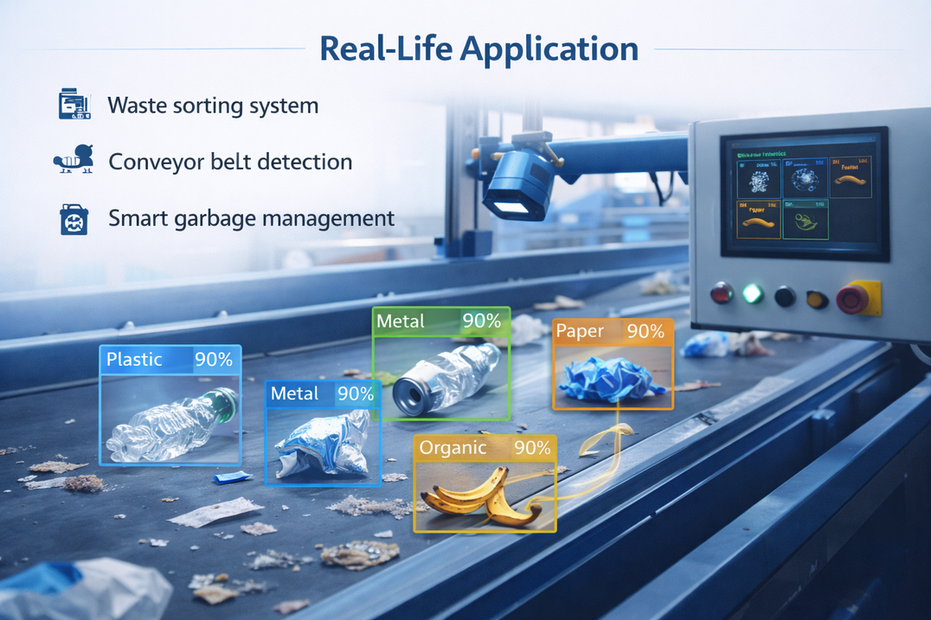
Real-Life Application
Waste sorting system
Conveyor belt detection
Smart garbage management

Slide 24
QUESTION?
24

Slide 25
THANK YOU
25

